Slide 1
Hands-on Machine Learning with Python
An Introduction to Sci-Kit Learn (sklearn)

Slide 2

Saurabh Bhatt
5+ years of experience in the field of Retail and 2+ years of experience in the field of Data Science
Worked mostly on Statistical Learning and Machine learning
Currently working on Bayesian Networks
Data Scientist @ Fractal Analytics

Slide 3
Prerequisite
Anaconda should be installed with python *.* version
Basic understanding of Matrix Algebra
Basic Understanding of Python Classes
Must have things

Slide 4
Machine Learning Classification
Classification Problem
(Logistic Regression)
Supervised Learning
Regression Problem
(Linear Regression)
Machine Learning
Dimensionality Reduction
(PCA)
Unsupervised Learning
Clustering
(K - Means)
Reinforcement Learning
Notes:
Supervised Learning
It is like teaching machines to learn the relationship between independent variables and the target Variable, similar to a way in whih a teacher provides the feedback to their students on their performance
We can divide the supervised learning problem into classification and regression
Unsupervised Learning
Algorithms learn by themselves without any supervision or without any target variable provided
Algorithm finds hidden pattern and relationship in the given data
Categories are DR and Clustering
Reinforcement Learning
Allows machine / Agent to learn its behaviour based on feedback from the environment
Closer to AI methodology rather than frequnetly used machine learning
Popular Games like atari

Slide 5
Steps in Building Machine Learning Models
Step 1
Step 2
Step 3
Step 4
Get the Data
Data Visualization and Generating Insights
Data Preparation for ML Algorithms
Train and Fine - tuning the model
Creating Isolated Environment
Importing data
Quick look on Data Structure
Creating a test set
Data Visualization
Looking for Correlations
Feature Engineering
Data Cleaning
Handling Text Attributes
Creating Pipelines
Training and Evaluation on training set
Better Evaluation using Cross Validation
Finalizing the model
Prediction on test set

Slide 6
Let’s get started...

Slide 7
Get the data
Create Workspace / Virtual Environment
Importing Data
Quick look at the data structure
Creating a test set

Slide 8
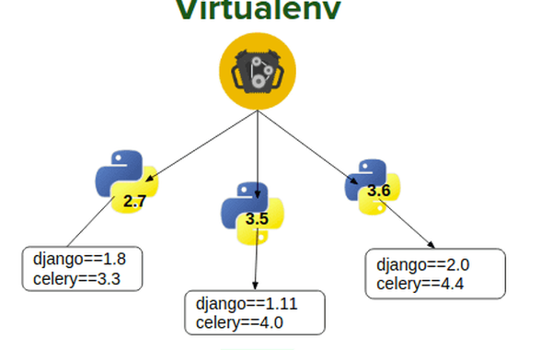
Create Workspace / Virtual Environment
Also known as Isolated environment
Allows us to work with different version of python and its packages for different projects
Two ways to install packages:
conda
pip
Local packages installation

Slide 9
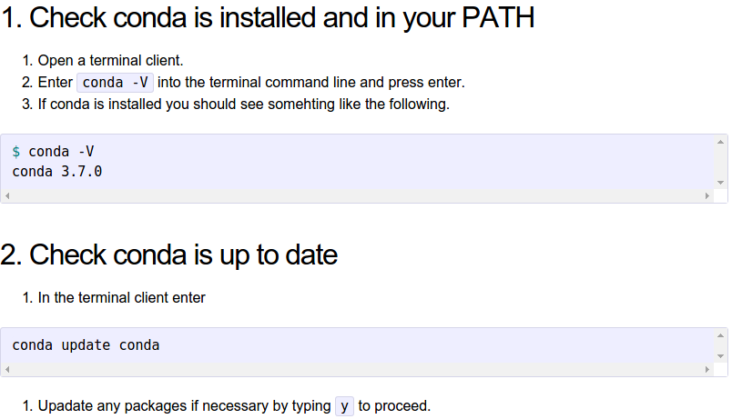
Codes for Creating Virtual Environment

Slide 10
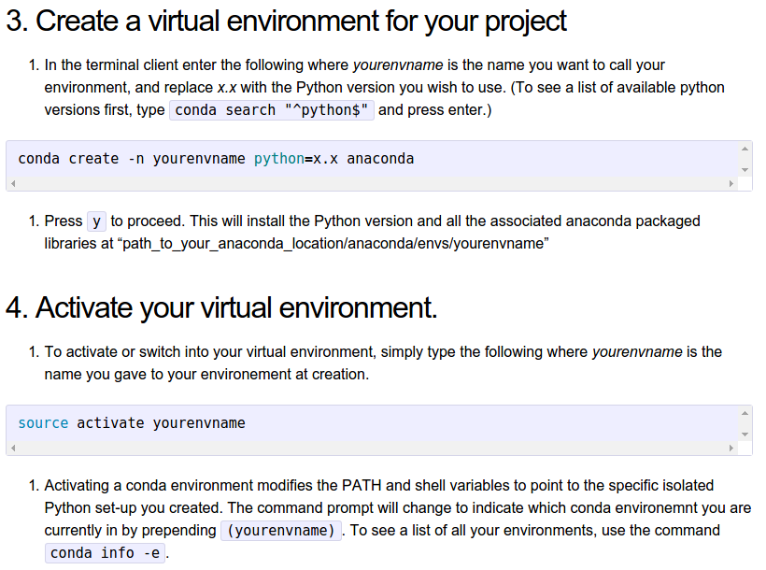
Codes for Creating Virtual Environment

Slide 11
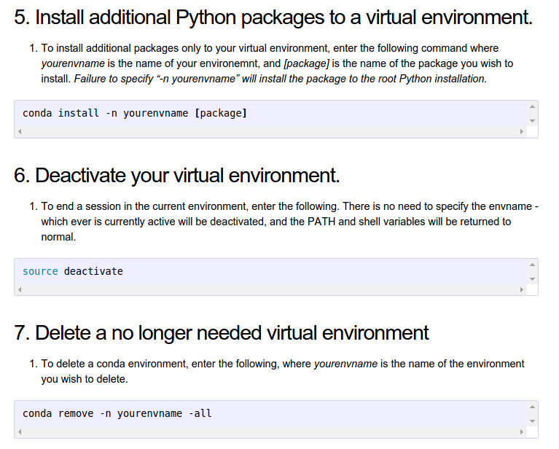
Codes for Creating Virtual Environment

Slide 12
Get the data
Create Workspace / Virtual Environment
Importing Data
Quick look on the data structure
Creating a test set

Slide 13
Get the data
Create Workspace / Virtual Environment
Importing Data
Quick look on the data structure
Creating a test set

Slide 14
Quick look on the data structure
The data is related with direct marketing campaigns of a Portuguese Banking Institution.
These marketing campaigns are based on phone calls
Classification goal is to predict if the client will subscribe a term deposit (variable y)
Find the data on below link:
https://archive.ics.uci.edu/ml/datasets/bank+marketing

Slide 15
Information about data features – 1
Bank – Client Data
age (numeric)
job (categorical: 'admin.’, 'blue-collar’, 'entrepreneur’, 'housemaid’, 'management’, 'retired’, 'self-employed’, 'services’, 'student’, 'technician’, 'unemployed’, 'unknown')
marital : marital status (categorical: 'divorced’, 'married’, 'single’, 'unknown'; note: 'divorced' means divorced or widowed)
education (categorical: 'basic.4y’, 'basic.6y’, 'basic.9y’, 'high.school’, 'illiterate’, 'professional.course’, 'university.degree’, 'unknown')
default: has credit in default? (categorical: 'no’, 'yes’, 'unknown')
housing: has housing loan? (categorical: 'no’, 'yes','unknown')
loan: has personal loan? (categorical: 'no’, 'yes’, 'unknown')

Slide 16
Information about data features – 2
Contact of the current campaign:
contact: contact communication type (categorical: 'cellular’, 'telephone')
month: last contact month of year (categorical: 'jan', 'feb', 'mar', ..., 'nov', 'dec’)
day of week: last contact day of the week (categorical: 'mon’, 'tue’, 'wed’, 'thu’, 'fri')
duration: last contact duration, in seconds (numeric). Important note: this attribute highly affects the output target (e.g., if duration=0 then y='no'). Yet, the duration is not known before a call is performed. Also, after the end of the call y is obviously known. Thus, this input should only be included for benchmark purposes and should be discarded if the intention is to have a realistic predictive model.

Slide 17
Information about data features – 3
other attributes:
campaign: number of contacts performed during this campaign and for this client (numeric, includes last contact)
pdays: number of days that passed by after the client was last contacted from a previous campaign (numeric; 999 means client was not previously contacted)
previous: number of contacts performed before this campaign and for this client (numeric)
poutcome: outcome of the previous marketing campaign (categorical: 'failure','nonexistent','success’)

Slide 18
Information about data features – 4
social and economic context attributes
emp.var.rate: employment variation rate - quarterly indicator (numeric)
cons.price.idx: consumer price index - monthly indicator (numeric)
cons.conf.idx: consumer confidence index - monthly indicator (numeric)
euribor3m: euribor 3 month rate - daily indicator (numeric)
nr.employed: number of employees - quarterly indicator (numeric)
Output variable (desired target):
y - has the client subscribed a term deposit? (binary: 'yes’, 'no')

Slide 19
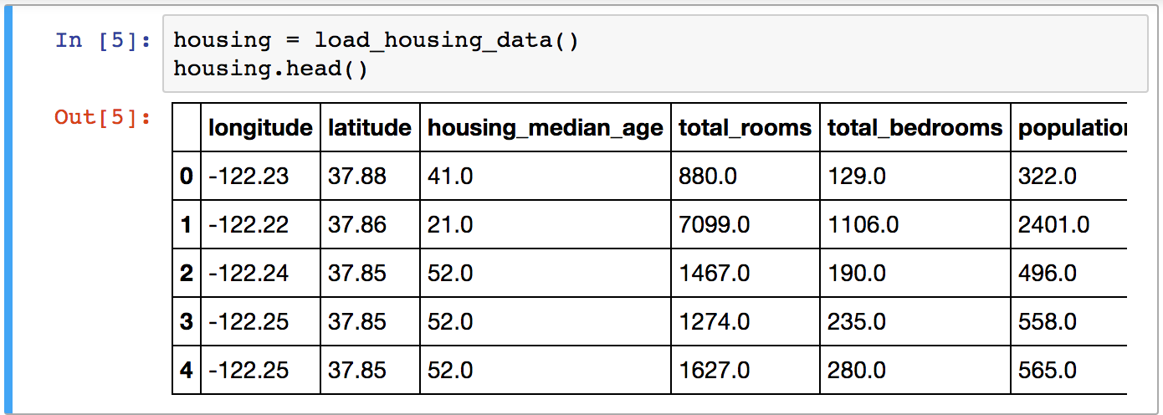
Codes...

Slide 20
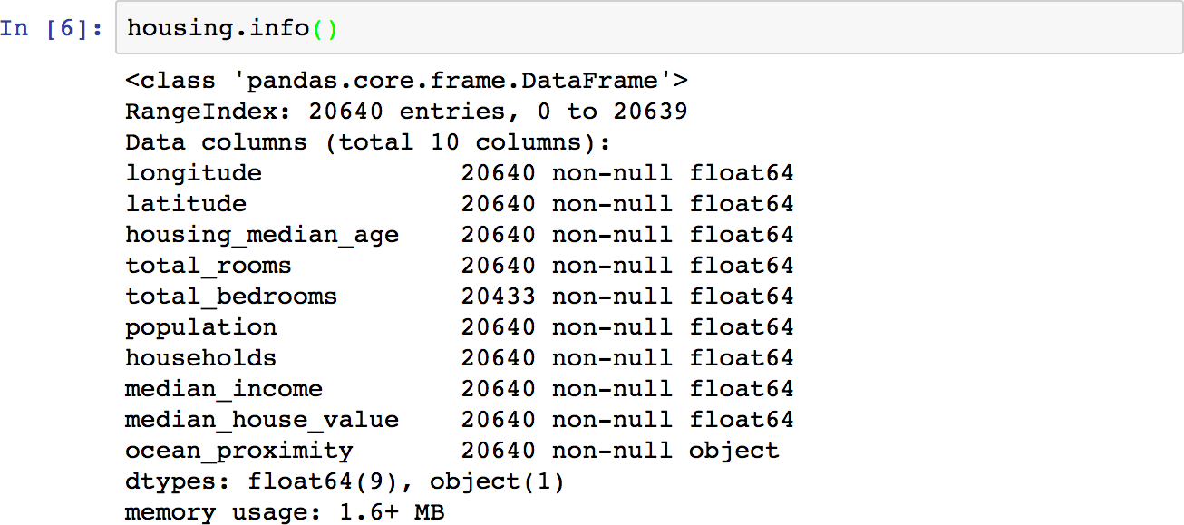
Codes...

Slide 21
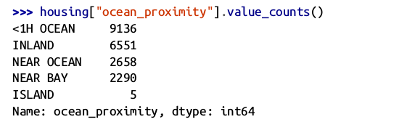
Codes...

Slide 22
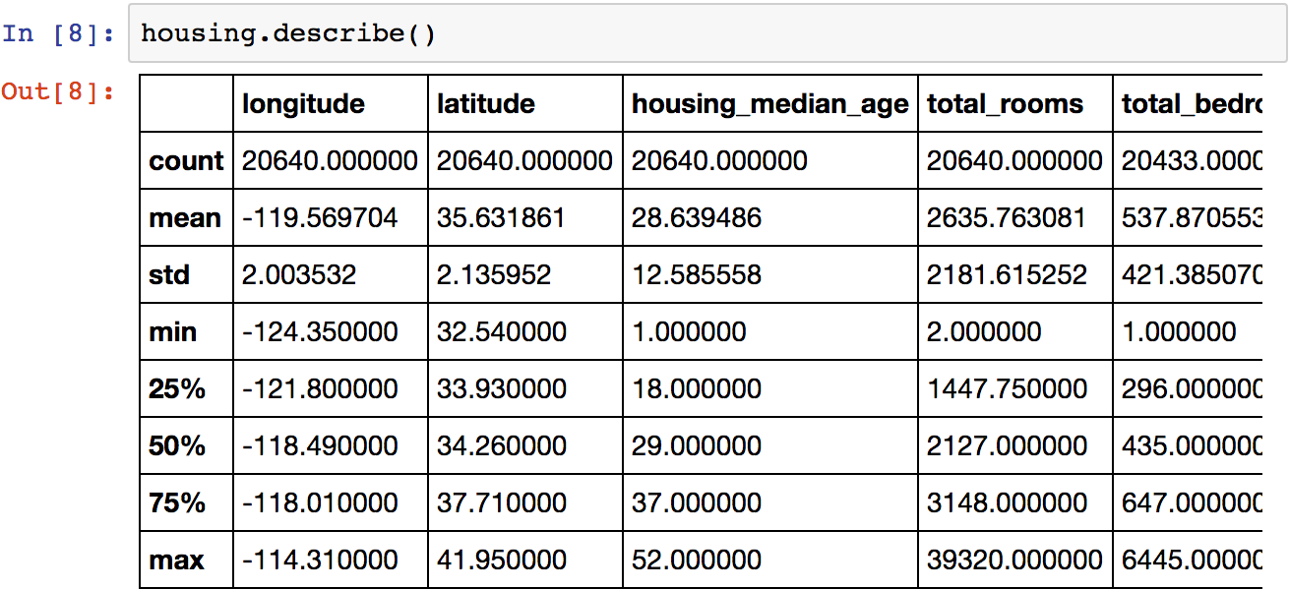
Codes...

Slide 23
Get the data
Create Workspace / Virtual Environment
Importing Data
Quick look on the data structure
Creating a test set

Slide 24
Creating a test set
Complete Data
Ratio is dependent on the size of the data
The following percentage for (Train : Validation : Test) are considered:
70:20:10
90:5:5
97:2:1
Train Data
Test Data
Training Set
Validation Set
Test Data

Slide 25

Code...

Slide 26
Data Exploration and
Visualization
Data Explorations
Data Visualization
Looking for Correlations
Experimenting with attribute Combinations (Feature Engineering)

Slide 27
Data Exploration and
Visualization
Data Explorations
Data Visualization
Looking for Correlations

Slide 28
Data Exploration and
Visualization
Data Explorations
Data Visualization
Looking for Correlations

Slide 29
Data Exploration and
Visualization
Data Explorations
Data Visualization
Looking for Correlations

Slide 30
Preparing data for ML algorithms
Data Cleaning / Missing Value Treatment
Handling Text and Categorical Attributes
Feature Scaling
Transformation pipelines

Slide 31
Preparing data for ML algorithms
Data Cleaning / Missing Value Treatment
Handling Text and Categorical Attributes
Feature Scaling
Transformation pipelines

Slide 32
Preparing data for ML algorithms
Data Cleaning / Missing Value Treatment
Handling Text and Categorical Attributes
Feature Scaling
Transformation pipelines

Slide 33
Preparing data for ML algorithms
Data Cleaning / Missing Value Treatment
Handling Text and Categorical Attributes
Feature Scaling
Transformation pipelines

Slide 34
Train and Fine-Tuning
the model
Training and evaluating on the training set
Better evaluation using Cross-Validation
Finalizing the model
Predicting the test set

Slide 35
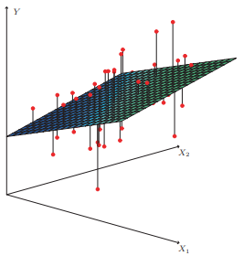
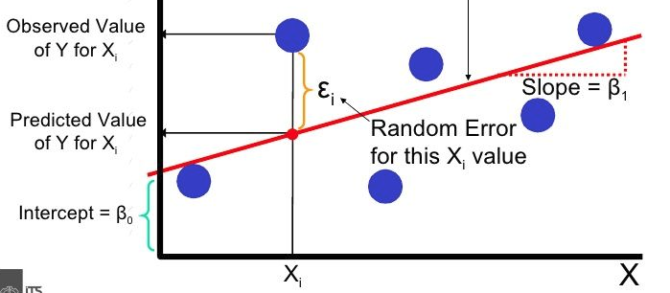



Quick Overview of Multiple Linear Regression
It is useful when the dependent variable is Quantitative
It tries to fit the linear relationship between X and Y
Simple Linear Regression,
Multiple Linear Regression
$y_{i}= β_{0}$ + $β_{1}X_{i}+ε_{i}$
$$Y$$
$y= β_{0}$ + $β_{1}X_{1}+β_{2}X_{2}$ + … $β_{n}X_{n}+ε$
Notes:
Multiple Linear Regression
An extension of Simple Linear Regression
Develops a relationship between a dependant variable aand multiple independent variables

Slide 36
Logistic Regression
It is useful when the dependent variable is qualitative
It tries to fit the linear relationship between X and logit(Y)

Slide 37
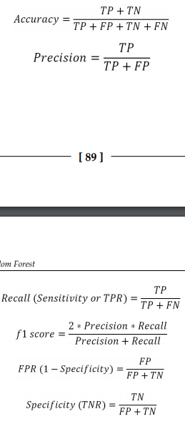
Confusion Matrix
Predicted Class
0
1
Observed
Class
0
TN
FP
1
FN
TP
TP | True Positive
TN | True Negative
FN | False Negative
FP | False Positive

Slide 38
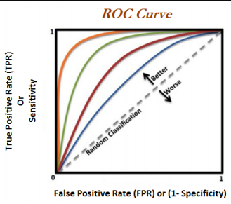
ROC Curve & AUC
ROC Curve
Also known as Receiver Operating Curve
Plot of test Sensitivity on the Y – axis versus its False Positive Rate (FPR) on the X – axis
Each discrete point on the graph called the Operating Point
AUC (Area Under the Curve)
AUC provides the overall measure of test accuracy
Higher the AUC the better the overall performance of the test

Slide 39
Train and Fine-Tuning
the model
Training and evaluating on the training set
Better evaluation using Cross-Validation
Finalizing the model
Predicting the test set

Slide 40
Bias - Variance Tradeoff

Slide 41
K - Fold Cross Validation
Train Data
Training Set
Training Set
Training Set
Validation Set
Training Set
Training Set
Validation Set
Training Set
Training Set
Validation Set
Training Set
Training Set
Validation Set
Training Set
Training Set
Training Set

Slide 42
Regularization - L1 and L2

Slide 43
Train and Fine-Tuning
the model
Training and evaluating on the training set
Better evaluation using Cross-Validation
Finalizing the model
Predicting the test set

Slide 44

Codes...
Model storing

Slide 45
Train and Fine-Tuning
the model
Training and evaluating on the training set
Better evaluation using Cross-Validation
Finalizing the model
Predicting the test set

Slide 46
Questions?

